Slide 1
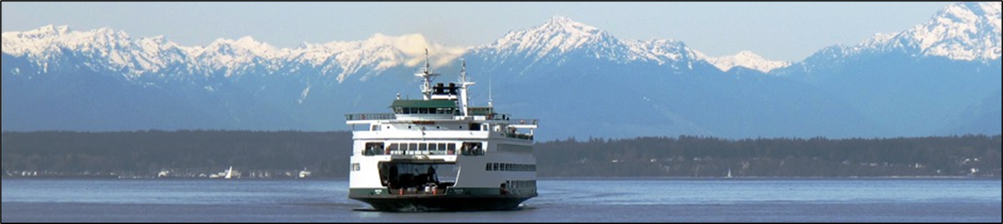
WASHINGTON STATE FERRIES
Puget Sound Regional Council Executive Board
Nicole McIntosh, Deputy Assistant Secretary, WSF
Sept. 28, 2023

Slide 2
Briefing agenda
System overview
Challenges for restoring service and maintaining reliability:
    Vessel availability
    Workforce recruitment, retention, development
Highlights
  New terminals
  Electrification
Support from PSRC

Slide 3
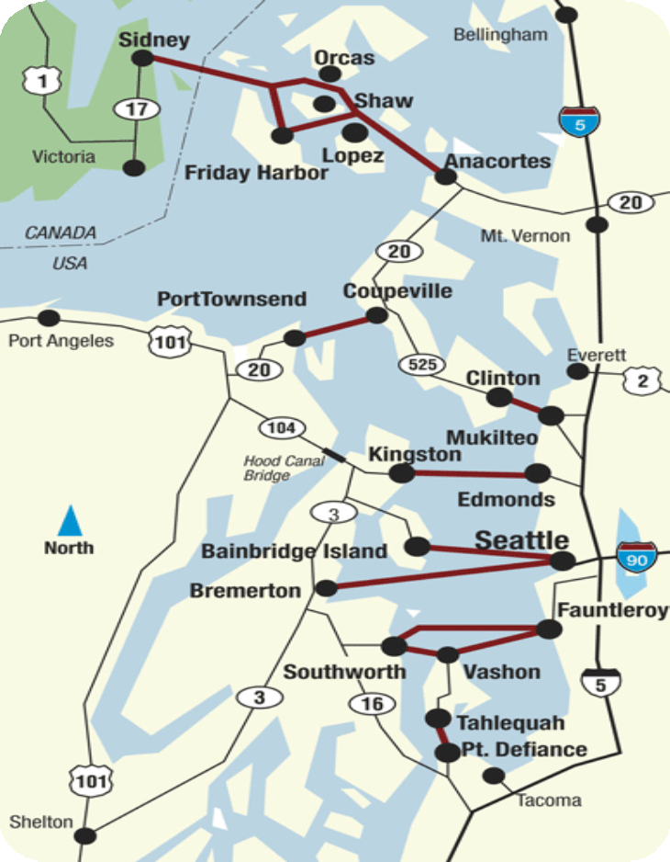
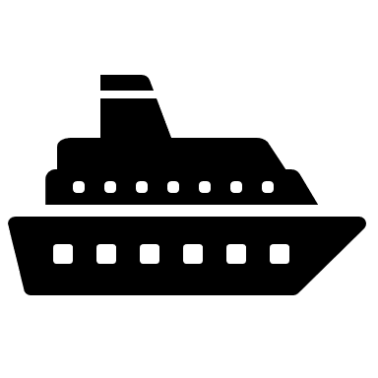




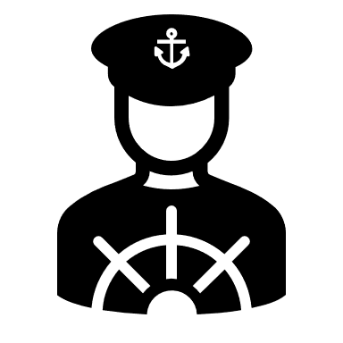
Our Ferry System
Largest ferry system in the United States
21 auto-passenger ferries
10 routes serving 20 terminals
23.9 million riders in 2019
10.5 million vehicles in 2019
450 sailings per day
1,800 employees

Slide 4
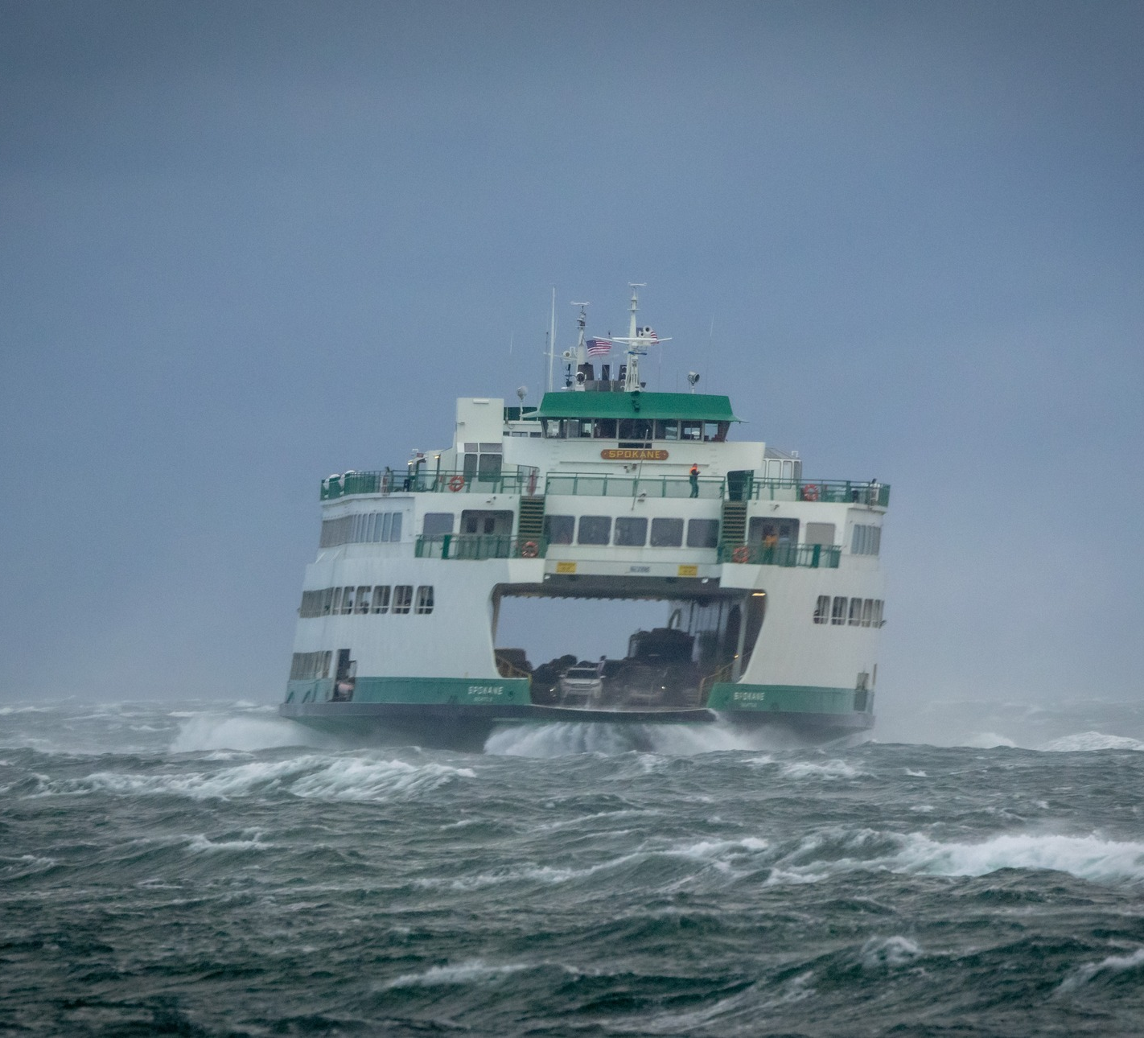



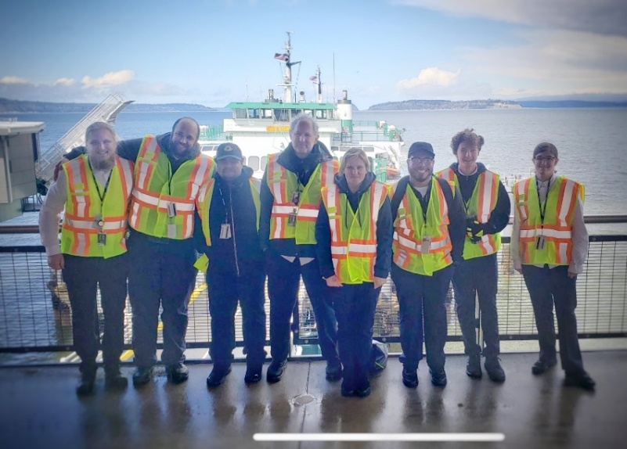




By The Numbers
Highlights and accomplishments from Jan. 1 – May 31, 2023
      6,887,863 total riders
      3,552,147 drivers (with vehicle)
      3,335,716 vehicle passengers and walk-ons
      58,273 trips completed
      312,557 service miles
      97.7% trip reliability
      25 Lifesaving events
      926 medical priority loads
      191 Whale sightings reported

Slide 5
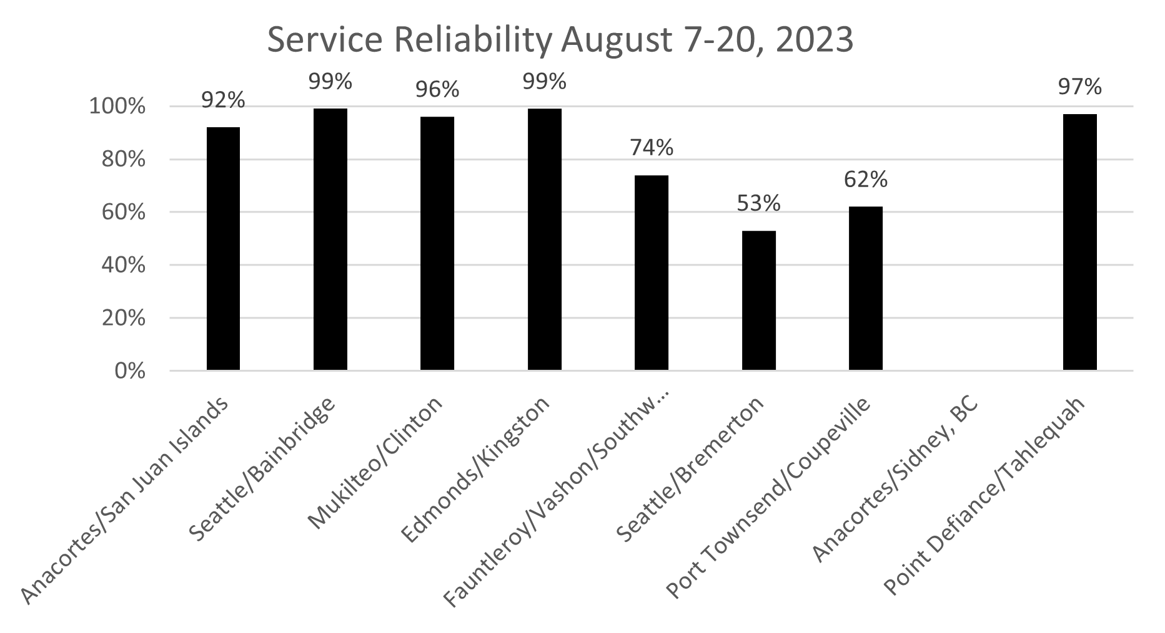
Reliability Metrics

Slide 6
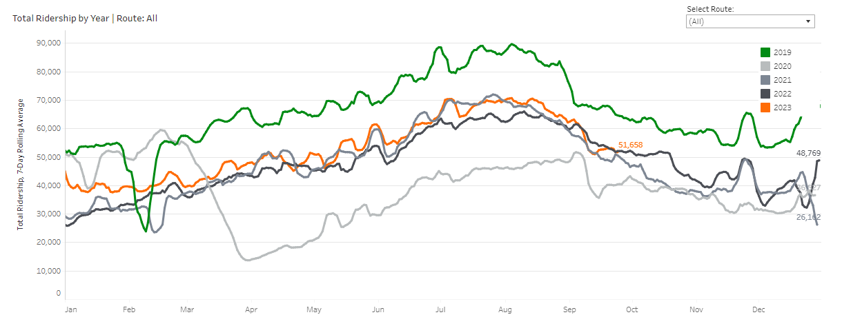
Rebounding Ridership
Total 2023 systemwide ridership compared to previous years

Slide 7
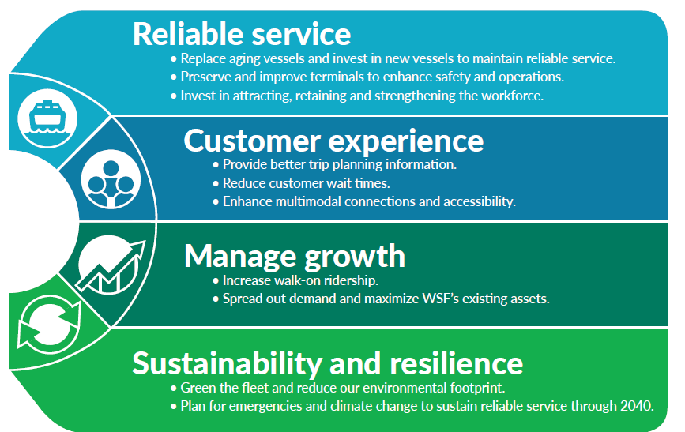
2040 Long Range Plan

Slide 8
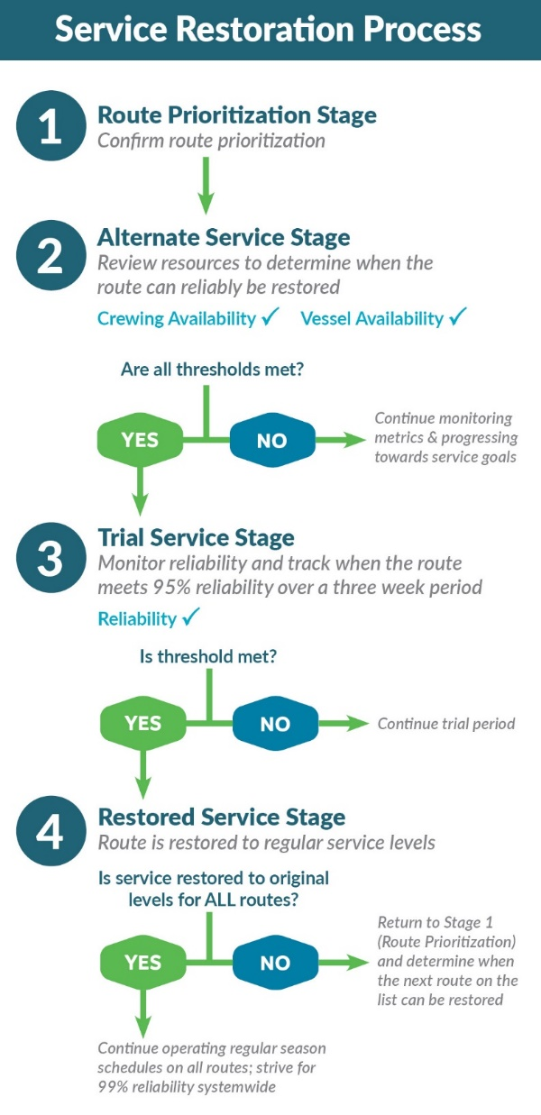
Service Restoration Process
Route prioritization
Anacortes/San Juan Islands
Seattle/Bainbridge
Mukilteo/Clinton
Edmonds/Kingston
Fauntleroy/Vashon Island/Southworth
Seattle/Bremerton
Port Townsend/Coupeville
Anacortes/Sidney BC
* Point Defiance/Tahlequah remains on one-boat service

Slide 9
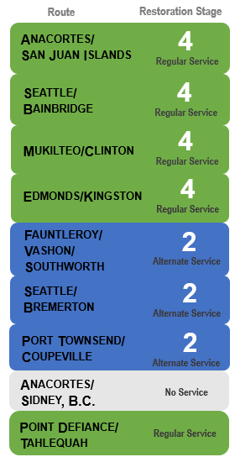
Service Restoration Progress
Timeline for service restoration
Anacortes/San Juan Islands
Restored Jan. 2022
Seattle/Bainbridge
Restored April 2022
Mukilteo/Clinton
Restored May 2022
Edmonds/Kingston
Restored Feb. 2023
Fauntleroy/Vashon/Southworth
Estimated restoration: Early-2024
Seattle/Bremerton
Estimated restoration: Early-2024
Port Townsend/Coupeville
Estimated Restoration: Spring 2024
Anacortes/Sidney, B.C.
Estimated restoration: 2030

Slide 10
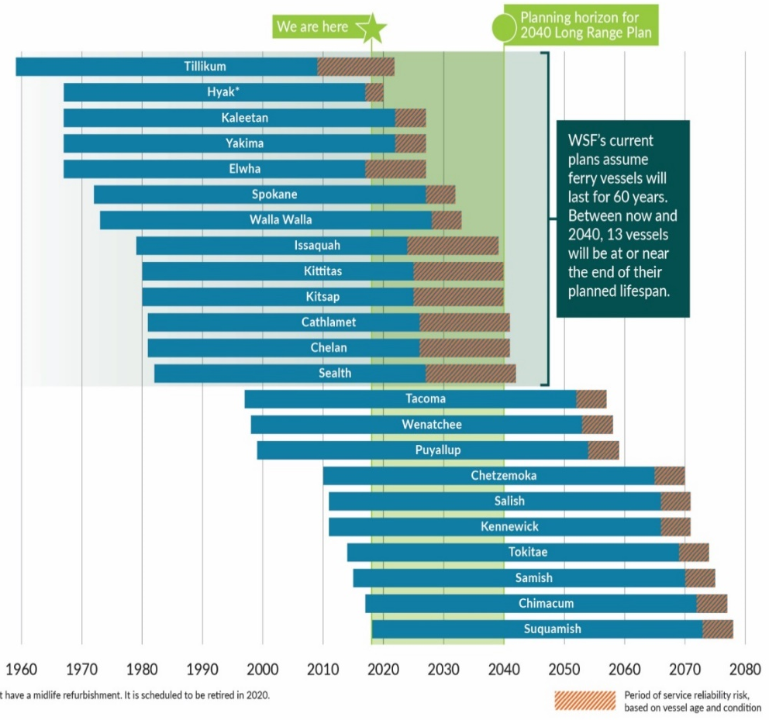
Vessel replacement
21 vessels in the fleet; with 15 currently in service due to scheduled maintenance, repairs, and hybrid conversion

Slide 11
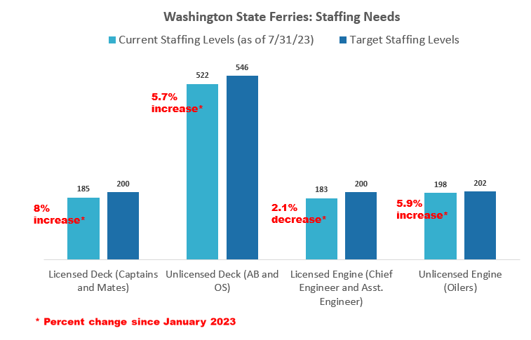
Crew Availability

Slide 12
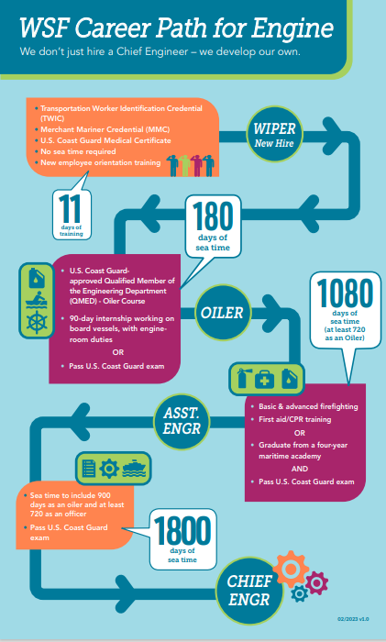
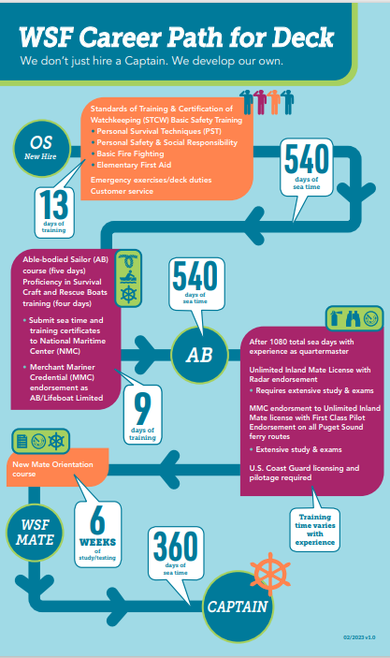
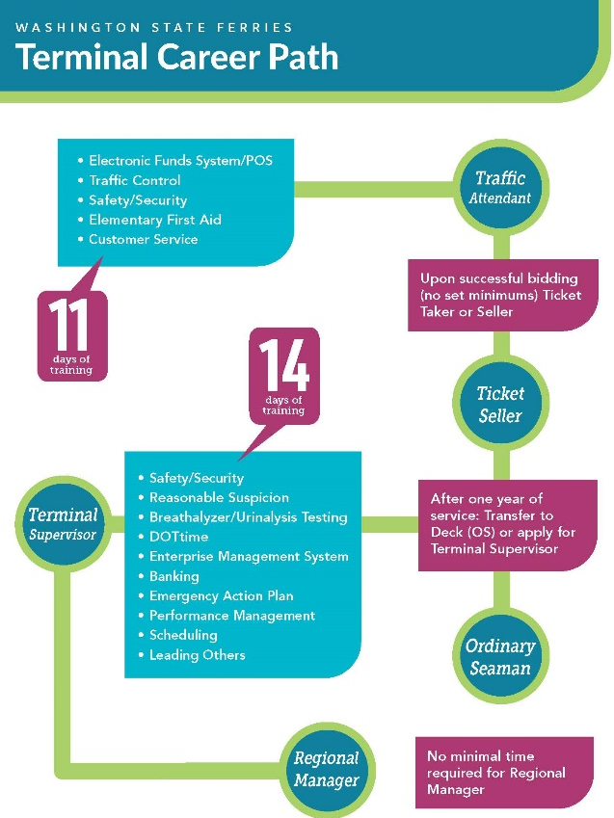
Providing Career Paths & Training for Retention

Slide 13
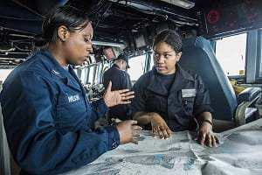
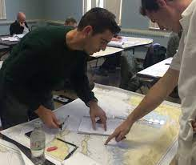
Workforce Development
Crewing and Workforce Investments Since 2022
$756,000 for New Mate Scholarship
$8.1 million for AB to Mate Program
$1.07 million for Engine Room Wiper Program
$6.66 million for Eagle Harbor Maintenance Facility second Shift
$1.02 million for Eagle Harbor Apprenticeships
$1.07 million for workforce development, including cultural issues, at the Washington state ferries (SB 5550)
$93,000 for Reimbursement of Lodging and TWIC Card costs

Slide 14
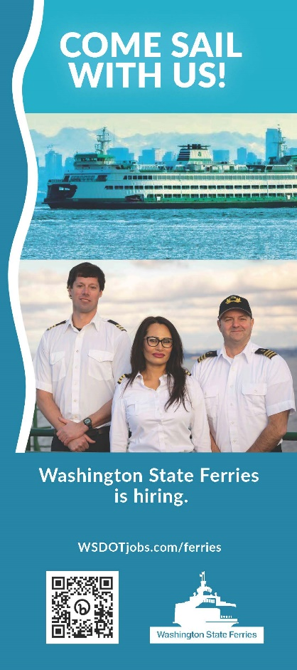
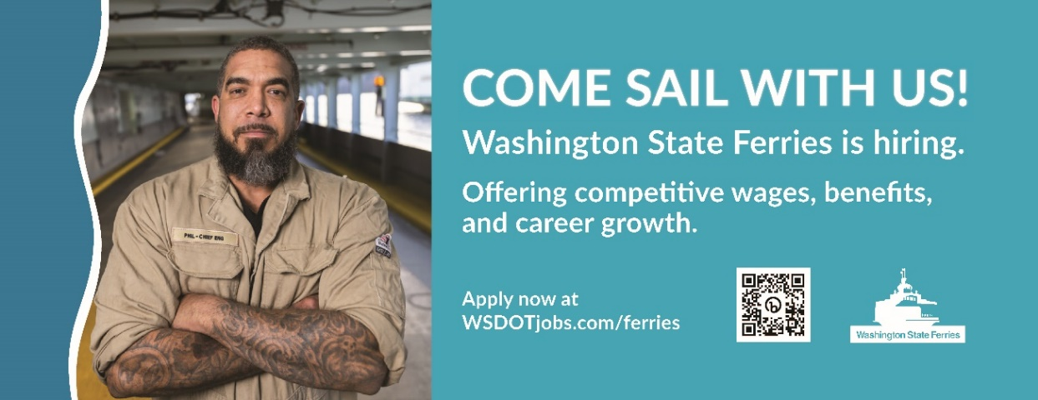
Advertising WSF Careers
Media Campaign
More than 3 million impressions across paid campaigns on Meta platforms, including Facebook, Instagram, and Messenger
Nearly half a million impressions from Tik Tok

Slide 15
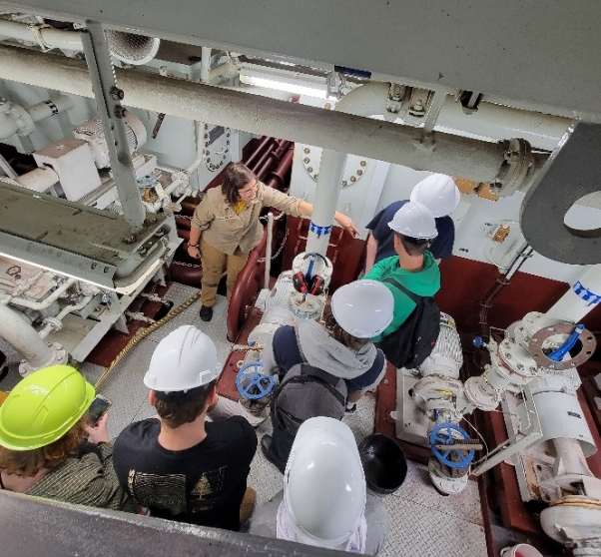
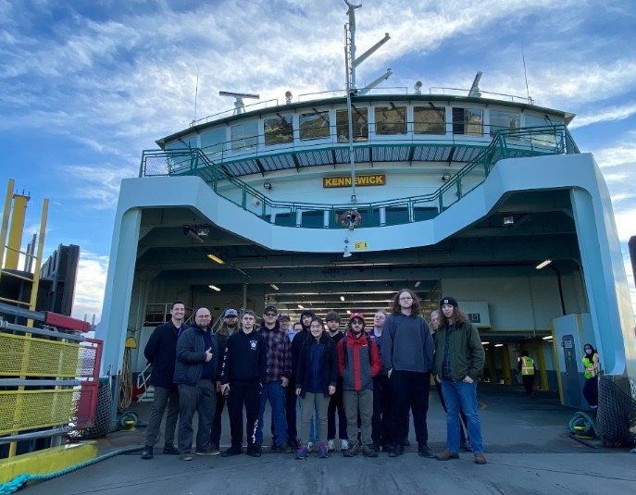
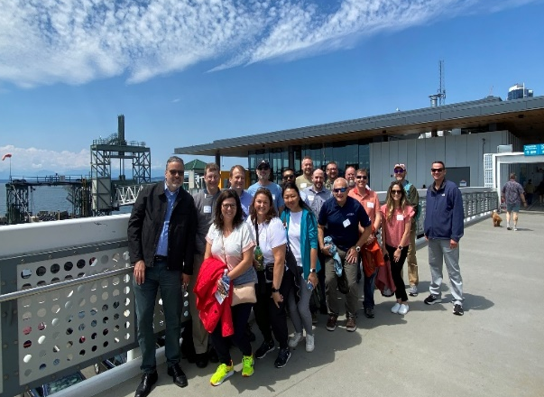
Recruitment Results for WSF Careers
More than 250 applications received for Deck & Terminal positions during the campaign
Saw a 7% increase in diversity in the Deck applicant pool
Had a 4.5% increase in Veteran applicants

Slide 16
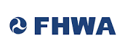
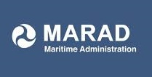
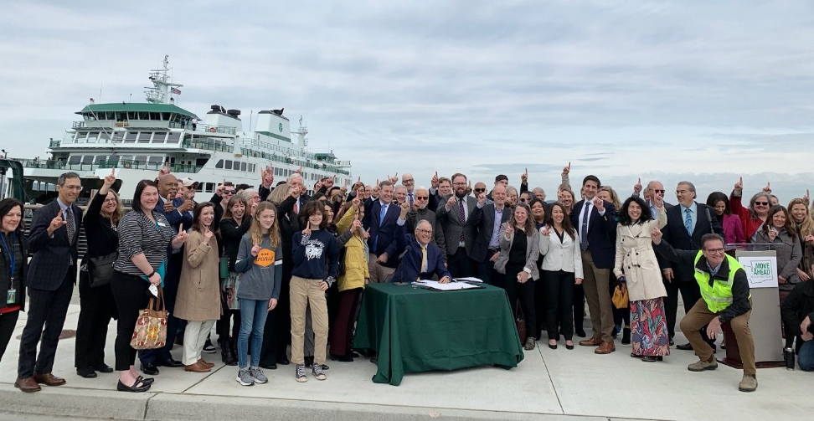
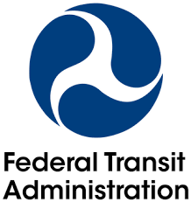



Investment in Action
$1.34 billion secured for electrification program from:
2022 Move Ahead Washington transportation package signing

Slide 17
Jumbo Mark II Conversions
Vigor awarded contract in Aug. 2023 for two vessels at $100 million; option for third vessel at $50 million
Dockside conversion (propulsion control system and hybrid electric)
Wenatchee to Vigor on Sept. 11 – return to service in late summer 2024
Tacoma in 2024 and Puyallup in 2025 if contract extended

Slide 18
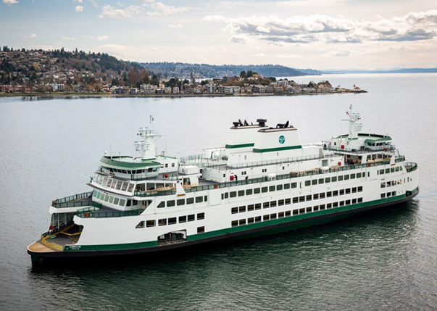




Hybrid Electric Olympic Class Builds
5 vessels, 2 routes (Clinton to Mukilteo, Seattle to Bremerton)
300 million gallons of diesel fuel saved over 60 years
$55 million lifecycle cost savings for five new vessels
Plan to award 1 or 2 contracts in 2024; vessel delivery spring 2027
Refining design for authorized procurement; draft bidding documents this fall

Slide 19
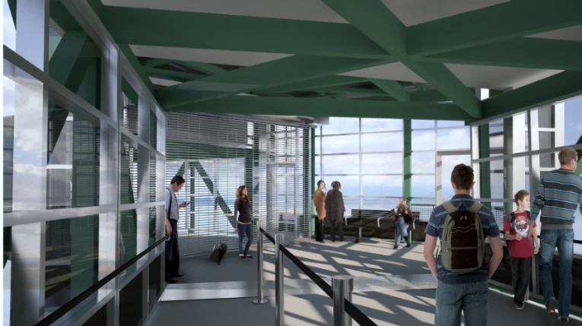
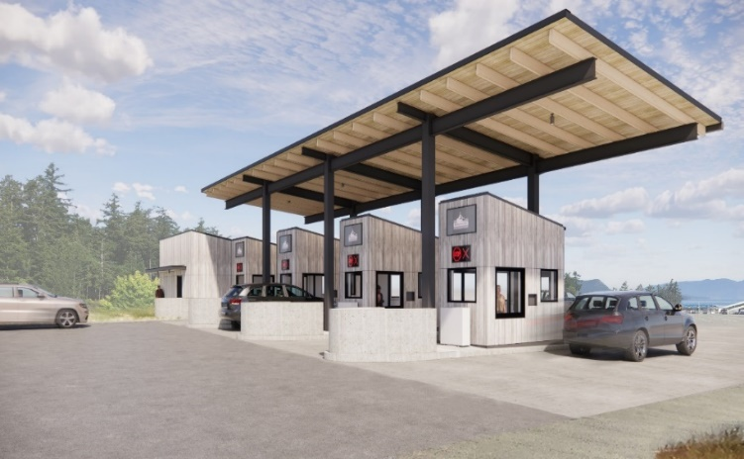
Investing in Our Terminals
Current Construction
Seattle Terminal at Colman Dock
Bainbridge Terminal Passenger Walkway
Anacortes Toll Booths
Design Phase
Fauntleroy Ferry Terminal Trestle Replacement
Anacortes Terminal Building
Kingston Seismic Retrofit – Trestle
And much more ahead

Slide 20

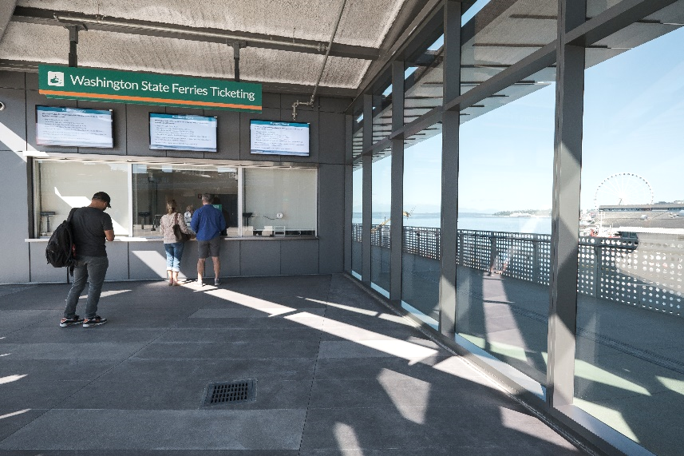
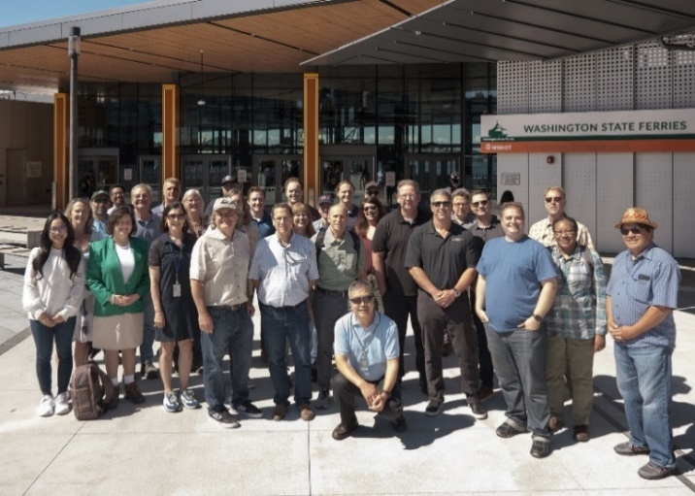
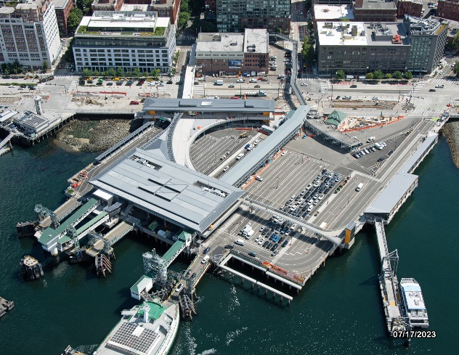
Seattle Terminal at Colman Dock
Opened Aug. 3, 2023

Slide 21
Support from PSRC
Understand the issues in vessels and crewing
Continue your outstanding support
Let us know if you have questions or know of other places where we should provide this story
Support our federal, state and local funding requests as appropriate

Slide 22
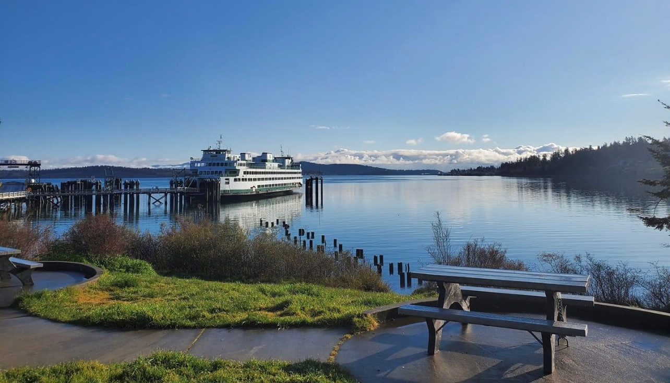
Questions?
Nicole McIntosh
Deputy Asst. Secretary
Washington State Ferries
mcintosh@wsdot.wa.gov

